Slide 1
William Shakespeare’s True Love
by Dr. Asim
Assistant Professor of English
Govt. Degree College, Bhojpur Moradabad

Slide 2
Famous as the greatest dramatist of the world
*Wrote 37 plays in English Literature
*Known as the writer of the sonnets and write 154 sonnets
*His famous tragedies-Macbeth, Othello, King Lear, Hamlet
Born at Startford-On-Avon, England
Knwn as the ‘Bard of Avon’

Slide 3
Shakespeare composed 154 sonnets and others poems
*The themes of his sonnets as love, time and beauty
Known his sonnets as English sonnets or Shakespearean sonnets
03 Quatrains and one couplet
Rhyme scheme-ABAB, CDCD, EFEF, GG
Written I iambic pentameter
The most popular love poems
Highlight the power and permanence of true love
True love never changes with passage of time
Love’s not time fools, not affected by physical beauty
True love is like a fixed mark
True love never shakes with fierce storms
True love is strong and eternal

Slide 4
Sensuous word picture as
O, no! It is an ever fixed mark, that looks on tempest
Use of Metaphor-Love is compared to a guiding star
Personification-Time is displayed as having power
The use of symbols and imagery-Star symbolizes guidance
Treated true love permanent and faithful
True love is unbreakable
Real love never fades but it remains strong until the en f life
The sonnets teaches the importance of loyalty and faith in love

Slide 5
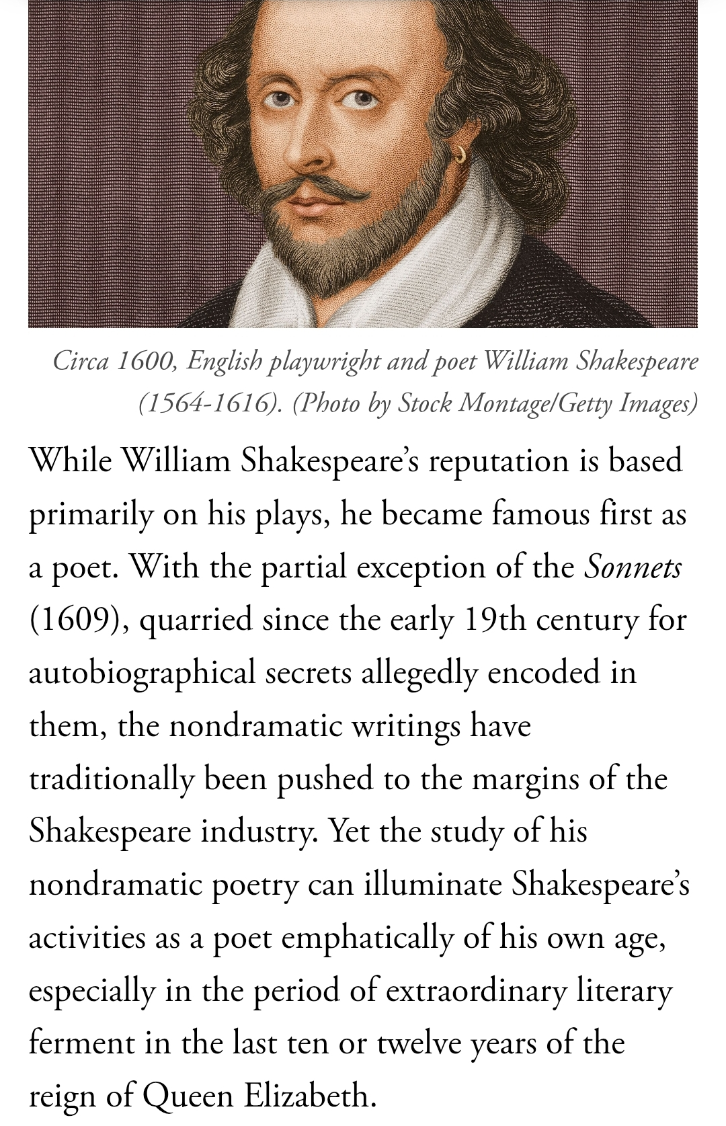

Slide 6
Constancy Love is the main theme of Shakespearean sonnets
True love remains firm even during problems
This sonnet is one of the most popular love poem
Thank you

