Slide 1
BESSEL’S DIFFRENTIAL EQUATION
SACHIN AGRAWAL (ASSISTANT PROFESSOR,MATHS )
GOVERNMENT DEGREE COLLEGE BHOJPUR,MORADABAD

Slide 2
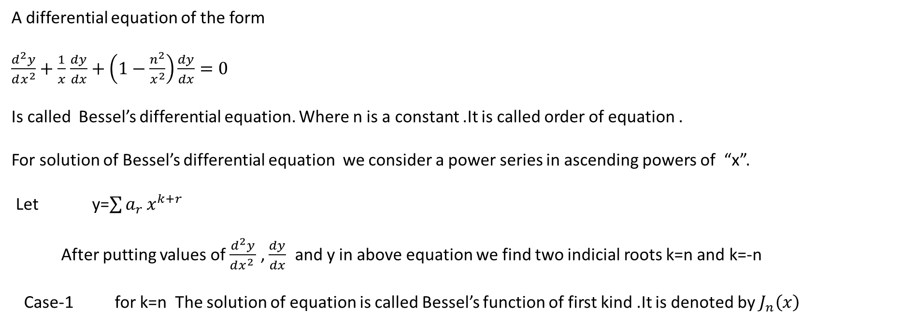
A differential equation of the form
$\frac{d^{2}y}{dx^{2}}+\frac{1}{x}$ $\frac{dy}{dx}+\left(1−\frac{n^{2}}{x^{2}}\right)\frac{dy}{dx}=0$
Is called Bessel’s differential equation. Where n is a constant .It is called order of equation .
For solution of Bessel’s differential equation we consider a power series in ascending powers of “x”.
Let y=$\sum{a_{r}}x^{k+r}$
After putting values of $\frac{d^{2}y}{dx^{2 }}$ , $\frac{dy}{dx}$ and y in above equation we find two indicial roots k=n and k=-n
Case-1 for k=n The solution of equation is called Bessel’s function of first kind .It is denoted by $J_{n}\left(x\right)$

Slide 3

$J_{n}\left(x\right)$ =$\sum_{r=0}^{∞}{{(−1)}^{r}}{\left(\frac{x}{2}\right)}^{n+2r}\frac{1}{r!(n+r)!}$
Case -2 When k=-n
The series solution is obtained by replacing n into –n in $J_{n}\left(x\right)$
$J_{−n}\left(x\right)$ =$\sum_{r=0}^{∞}{{(−1)}^{r}}{\left(\frac{x}{2}\right)}^{−n+2r}\frac{1}{r!(−n+r)!}$
above solution is called Bessel’s function of second kind . It is also denoted by $Y_{n}\left(x\right)$ .
General Solution of Bessel’s equation is
y =A $J_{n}\left(x\right)$ + B $Y_{n}\left(x\right)$
where A and B are arbitrary constants.

Slide 4

Bessel’s function of zeroth order :
It is denoted by $J_{0}\left(x\right)$.It is obtained by putting n=0 in $J_{n}\left(x\right)$ .
$J_{0}\left(x\right)$ = 1 - $\frac{x^{2}}{2^{2}}$ + $\frac{x^{4}}{2^{2.}4^{2}}$ - $\frac{x^{6}}{2^{2.}4^{2.}6^{2}}$ +$⋯⋯∞$
Recurrence formulaes of $J_{n}\left(x\right)$
x $J_{n}^{′}\left(x\right)$ = n $J_{n}\left(x\right)$ - x $J_{n+1}\left(x\right)$
x$J_{n}^{′}(x)$ = -n$J_{n}\left(x\right)+xJ_{n−1}\left(x\right)$
2$J_{n}^{′}\left(x\right)$ =${ J}_{n−1}\left(x\right)$ - $J_{n+1}\left(x\right)$
2n $J_{n}\left(x\right)$= x $\left[J_{n−1}\left(x\right)+J_{n+1}(x)\right]$
$\frac{d}{dx}$ $\left[x^{−n}J_{n}(x)\right]$ = -$x^{−n}J_{n}$(x)
$\frac{d }{dx}$ $\left[x^{n}J_{n}(x)\right]$ = $x^{n}J_{n−1}$(x)

Slide 5
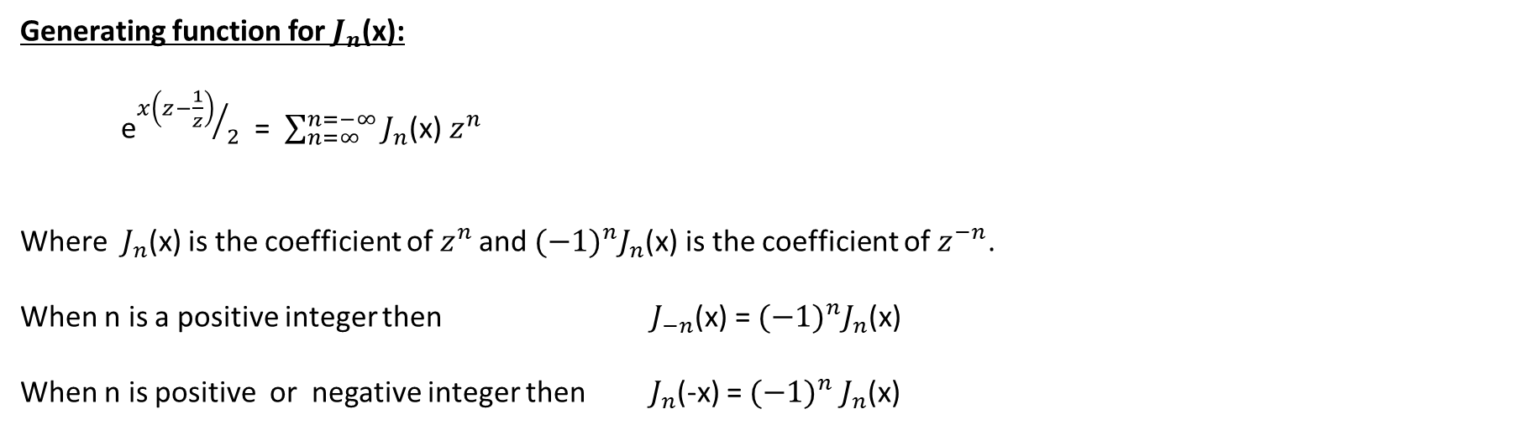
Generating function for $J_{n}$(x):
e${x\left(z−\frac{1}{z}\right)}/2$ = $\sum_{n=∞}^{n=−∞}{J_{n}}$(x) $z^{n}$
Where $J_{n}$(x) is the coefficient of $z^{n }$and ${(−1)}^{n}J_{n}$(x) is the coefficient of $z^{−n}$.
When n is a positive integer then $J_{−n}$(x) = ${(−1)}^{n}J_{n}$(x)
When n is positive or negative integer then $J_{n}$(-x) = ${(−1)}^{n}$ $J_{n}$(x)

Slide 6

$J_{1/2}$(x) = $\sqrt{\frac{2}{πx}}$ sinx
$J_{{−1}/2}$(x) = $\sqrt{\frac{2}{πx}}$ cosx
$J_{3/2}$(x) = $\sqrt{\frac{2}{πx}}$ $\left(\frac{sinx}{x}−cosx\right)$
$J_{{−3}/2}$(x) = $−\sqrt{\frac{2}{πx}}$ $\left(\frac{cosx}{x}+sinx\right)$

Slide 7
THANK YOU

